Slide 1

VALLURUPALLI NAGESWARA RAO VIGNANA JYOTHI
INSTITUTE OF ENGINEERING AND TECHNOLOGY
MEDI_AR
Day by day the medical facilities are improving along with new diseases. which results in development of new drugs daily into the market which has different uses at different situations. The small change in the dosage misunderstanding leads to lose of life's. So give general idea to every Doctors/patients/pharma companies/illiterate person/Blind people to recognize what medicine to be taken in which quantity by simply scanning the drug using the camera of any smartphone.
Methodology
The most advanced technology AR(augmented reality) is used to resolve this problem. By using drugs labels as the image targets as the input source, A detailed pop of the drug which contains purpose, usage & quantity is augmented as output.
For this purpose we are going to use unity 3D editor with Vuforia support
Basically we are going to have the database which contains image targets as the label of drug’s & the content related to each of the label Which describes the quantity & purpose of drug.
In the case of blind & illiterate people the voice-over in different regional languages is provided.

Slide 2

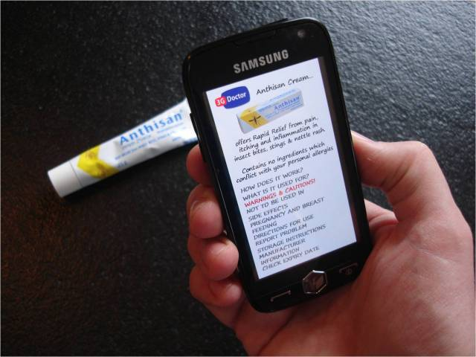
VALLURUPALLI NAGESWARA RAO VIGNANA JYOTHI
INSTITUTE OF ENGINEERING AND TECHNOLOGY
MEDI_AR
Enhancing medicine packages for health literacy improvement
mediAR app solution will seek to improve health literacy from many diseases and related medications.
For visually impaired the app gives voice-over of the medical description, purpose of drug and dosage...etc
Charts or photographs
Augmentation of text for clear display
Video tutorial by scanning trigger in cases if don't know how to use.
Voice over in many regional languages which helps for many illiterate people.
Reduces medication error in case of high and low dosage of medication
everyone can use it from Doctors/patients/pharma companies and even illiterate & visually impaired.

Slide 3
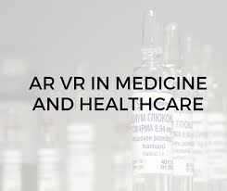
VALLURUPALLI NAGESWARA RAO VIGNANA JYOTHI
INSTITUTE OF ENGINEERING AND TECHNOLOGY
MEDI_AR
mediAR reduce improper usage of drug
Reduces errors, in case of incorrectly Filling A Prescription
Increases the Interactions with Drug
Reduces unnecessary medicines
Unnecessary medicines :
Sometimes doctors may feel it's not their responsibility to withdraw medications prescribed by another doctor, so patients may be prescribed something for a temporary condition that has since resolved. One of our members alerted us to another problem resulting from lack of clear communication between doctor and patient: that of when to stop taking medications with repeat prescriptions. This has also led to patients being prescribed a new brand of a particular medicine — or given a generic instead of a brand – but taking both the old and the new at the same time.

Slide 4
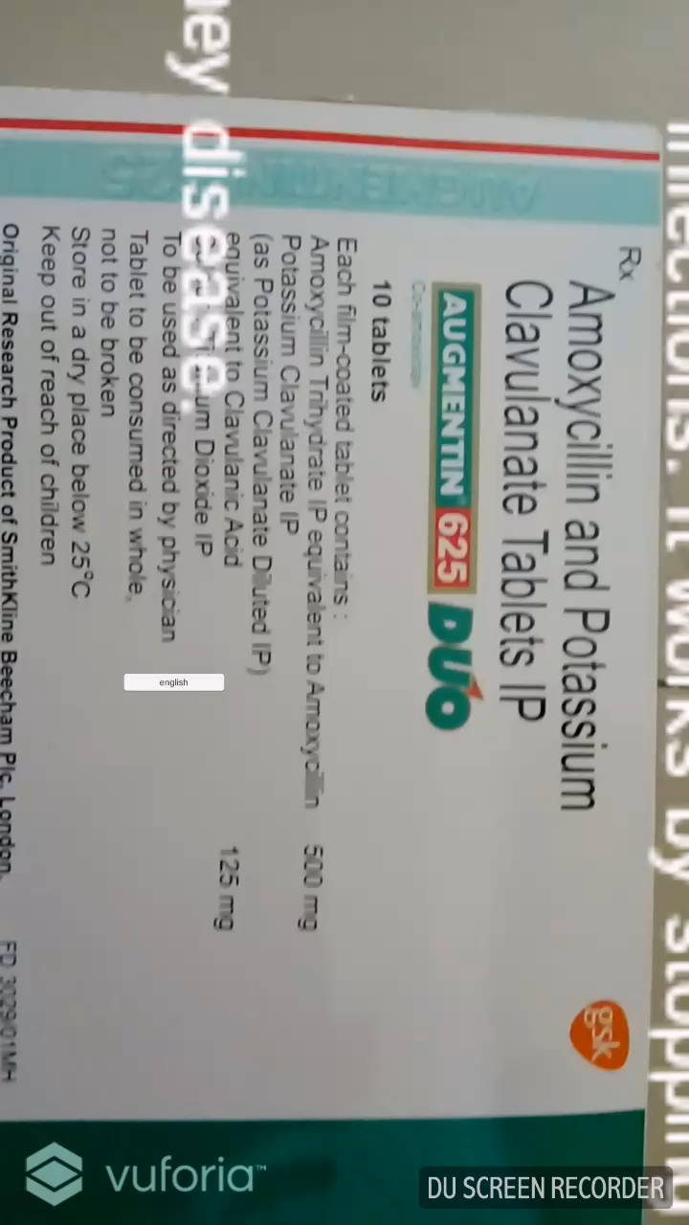

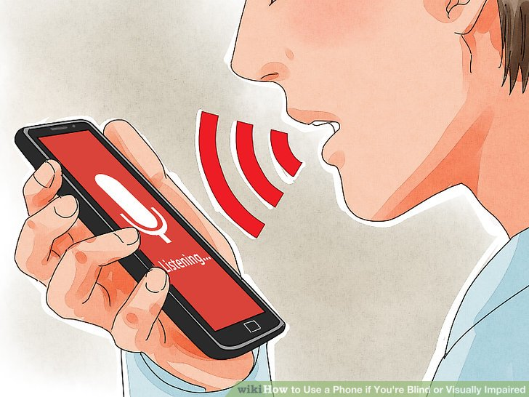
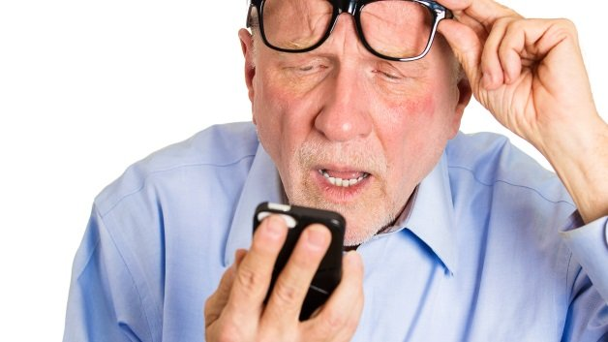
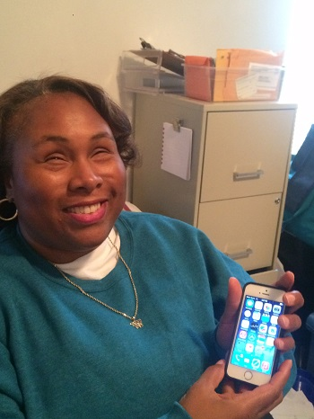
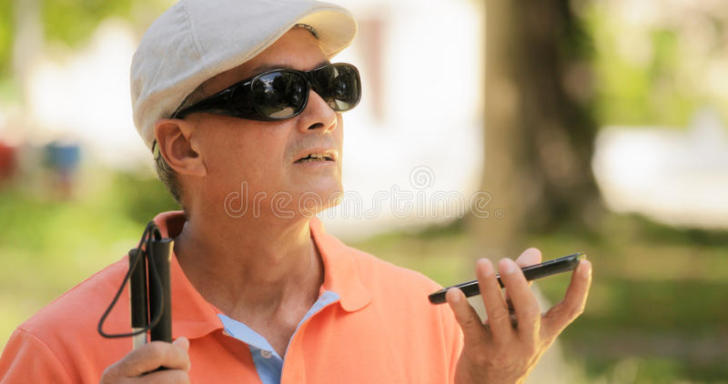
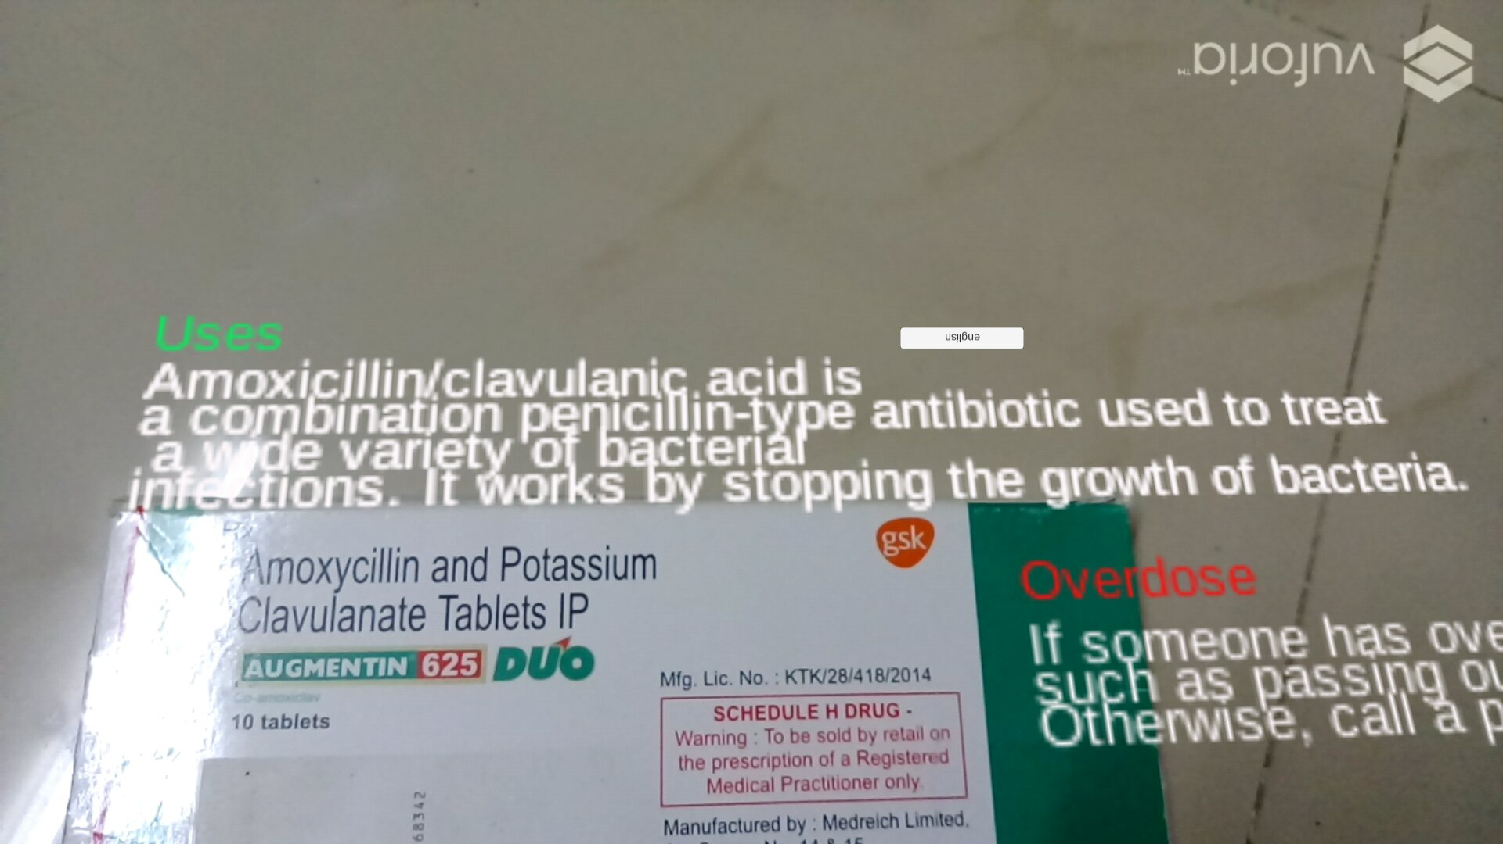
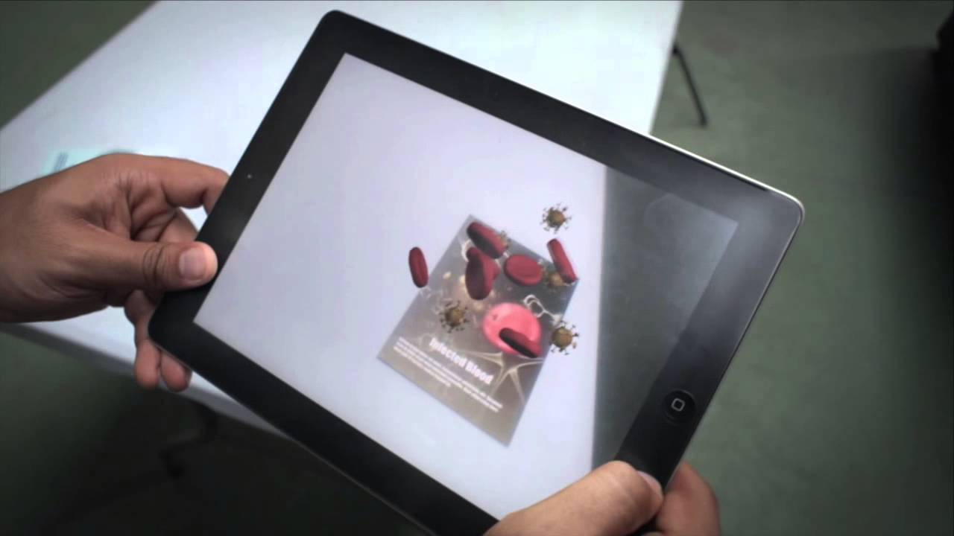
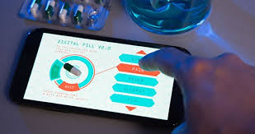
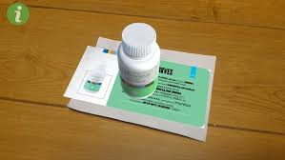
VALLURUPALLI NAGESWARA RAO VIGNANA JYOTHI
INSTITUTE OF ENGINEERING AND TECHNOLOGY
MEDI_AR
Regional language |  | Photo 01 |  | Photo 02
Visually Impaired |  | Photo 05 |  | Photo 06 |  | Photo 07
3D Augmentation |  |  |  | Photo 10 |  | Photo 11

